Slide 1
Zero Emission Vehicle Working Group
EV Infrastructure Survey
April 2021

Slide 2
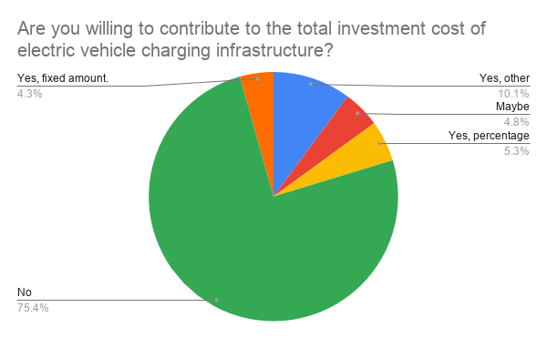
EV Infrastructure Investment

Slide 3
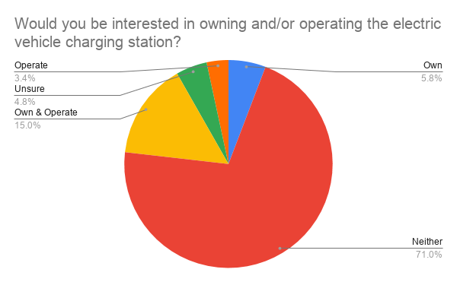
EV Infrastructure Investment

Slide 4
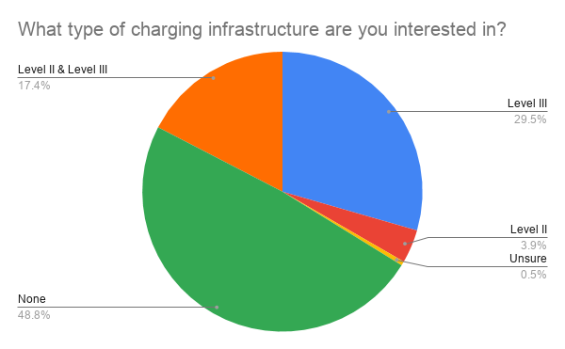
EV Infrastructure Investment

Slide 5
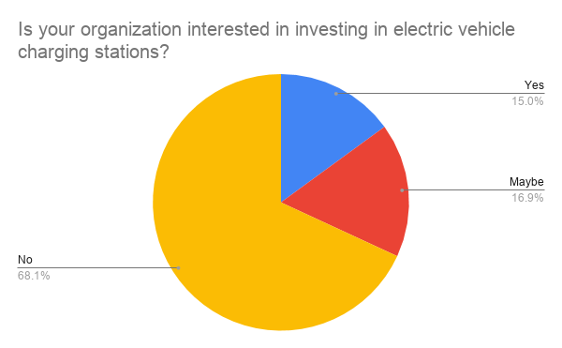
EV Infrastructure Investment

Slide 6
EV Survey Specifics
Federal Requirements
217 Respondents
44 willing to help fund EV infrastructure
39 willing to help fund some sort of Level III fast charging
10 willing to commit between 5% and 100% of the cost

